Slide 1


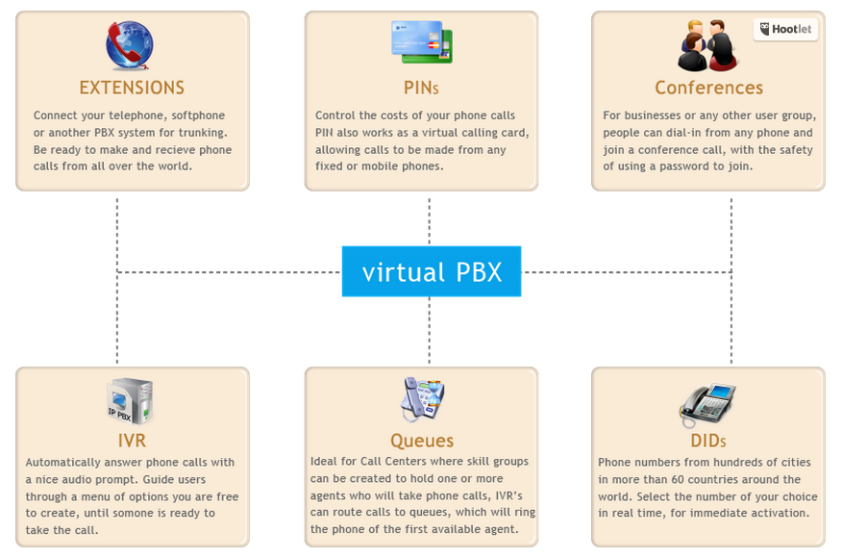


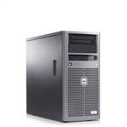
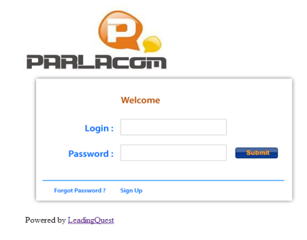



LQ2000
LQ2000
Products and Services Parla VoIP
LQ2000
IPBX LQ2000
Contact Center solution
No maximum limit for users
Full IP-based System
SIP with national and international carriers
Support to E1 and interfaces FXS e FXO
Unlimited SIP, IAX trunks
  Corporate, high performance PBX
  Same benefits of a traditional PBX
  Unlimited trunks
  Call recording
  IVR – Interactive Voice Response
  Queues and Group handling
  Dialers
  Conference Rooms
  Phone numbers from over 60 countries
  Interfaces E1 ISDN and GSM mobile gateways
  SMS Gateways, Instant Messengers, fax – Unified Communications Center
LeadingQuest – USA & Brazil

Slide 2

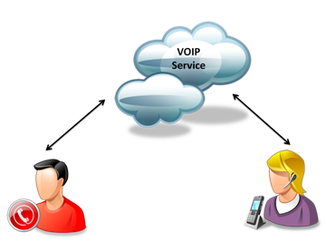
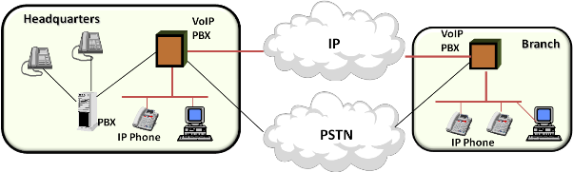


LQ2000
LQ2000 (cont.)
Target Profile
Plataforma M2M na “Nuvem”
Unlimited hierarchy levels
Unlimited IVR's, menus, submenus
Unlimited Groups
Unlimited Dialers
Unlimited Conferences
Unlimited Extensions, PINs and SIP Trunks
Intelligent routing through cheaper routes
Advanced plan with thousands of rate cards
Support to sending and receiving SMS
RoboCalls for automated calling
Companies wanting
Call Center solutions;
Need to improve customer support;
IP advanced technology;
Telemarketing business, inbound and outbound
Companies needing advanced functionalities, like:
  IVR
  Intelligent Dialer and Telemarketing Campaigns
  Queue Control
  Call recording
  Call Center Supervisor with remote listening mode
  Call Center Agents
  Public Numbers and Phone Calls
  Campaigns and Dialer
  Unlimited Dialers
Public Numbers and Phone Calls
Campaigns and Dialer
Unlimited Dialers
Multiple Campaigns running, independently
Customizable Reports
Availability control of agent and extensions
Routing calls for handling queues, recorded messages, voice mail, ERA, etc.
Dialer only makes and transfers calls for ready agents
Dialer use for RoboCall services
Numbers from over 60 countries
Immediate, online activation
Calling every destinations in Brazil and in the world, for a lower amount
LeadingQuest – USA & Brazil

Slide 3


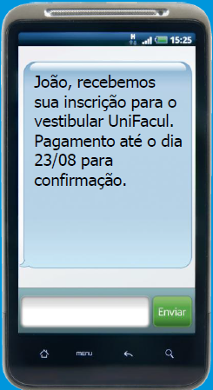
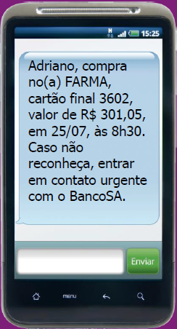
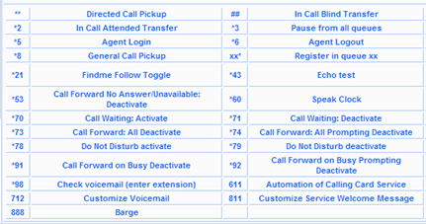
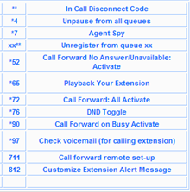

LQ2000
SMS – Sending and Receiving Messages
Mensagens
Call Center Agents
Other Features
Sending SMS via web portal
Sending SMS via Gtalk
Sending SMS via your system, with our integrated APIs
Receiving SMS via email
Automated campaigns
Exclusive tags to receive SMS
Multiple advanced resources using traditional phones, IP phones or Windows softphones
Queue control; dynamic access; pause and resume capabilities
Advanced PBX resources
Call Center Supervisor
Unlimited hierarchy level
Unlimited supervisors, menus, submenus
Dynamic and static agent support to queues
“Spy” functions for supervisors, allowing remote listening and monitoring.
LeadingQuest – USA & Brazil

Slide 4

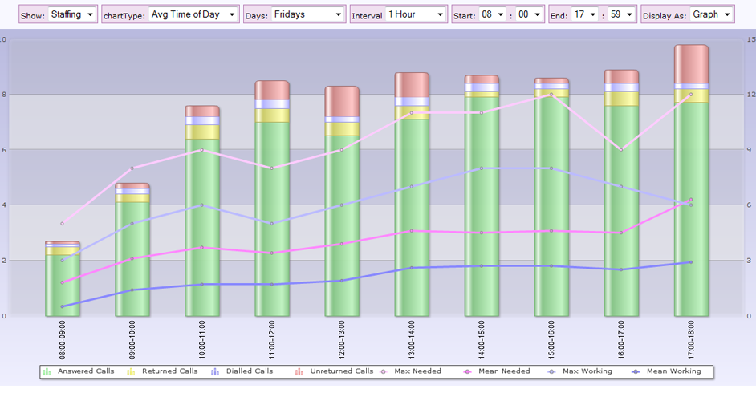
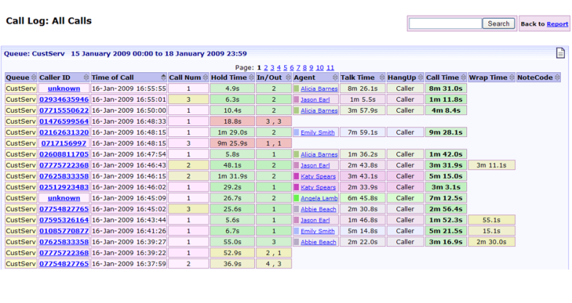
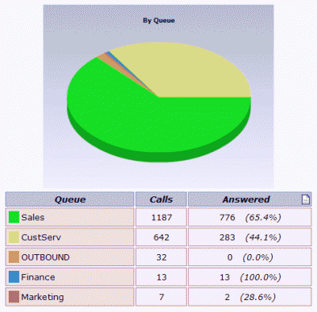
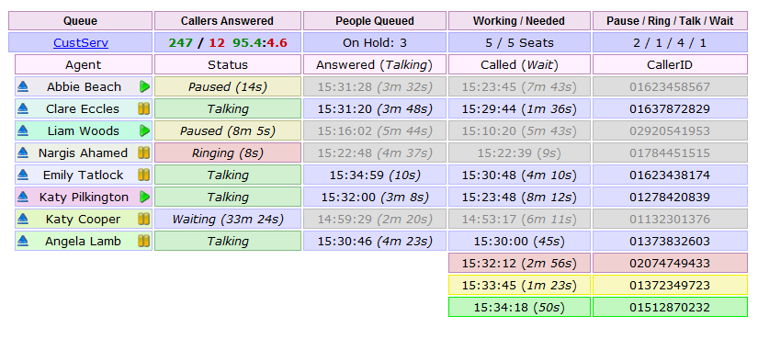
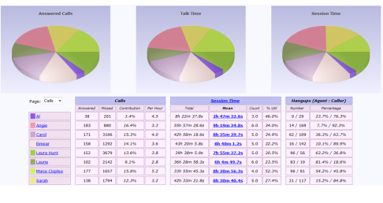
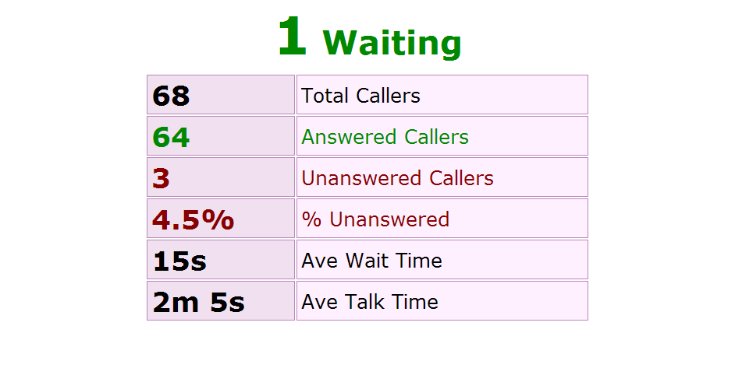

LQ2000
Call Recording
Recording management:
  Configurable by agent, regardless the workstation in use
  Easy record tracking
    By CallerID
    By agent’s login or extension
    By date/time
  WAV ou MP3
  Easy FTP backup
IVR's:
Unlimited IVR's, menus, submenus
Audio recording using phone itself
Unlimited keyboard options by IVR's
Choose any destination in the menu
Call Center Performance Reports
Main Benefits
Cutting Operation Costs
Advanced Tools
Productivity Gains
Improved Call Center Flexibility
High Return on Investment
Total Customer Orientation
LeadingQuest – USA & Brazil

